Slide 1
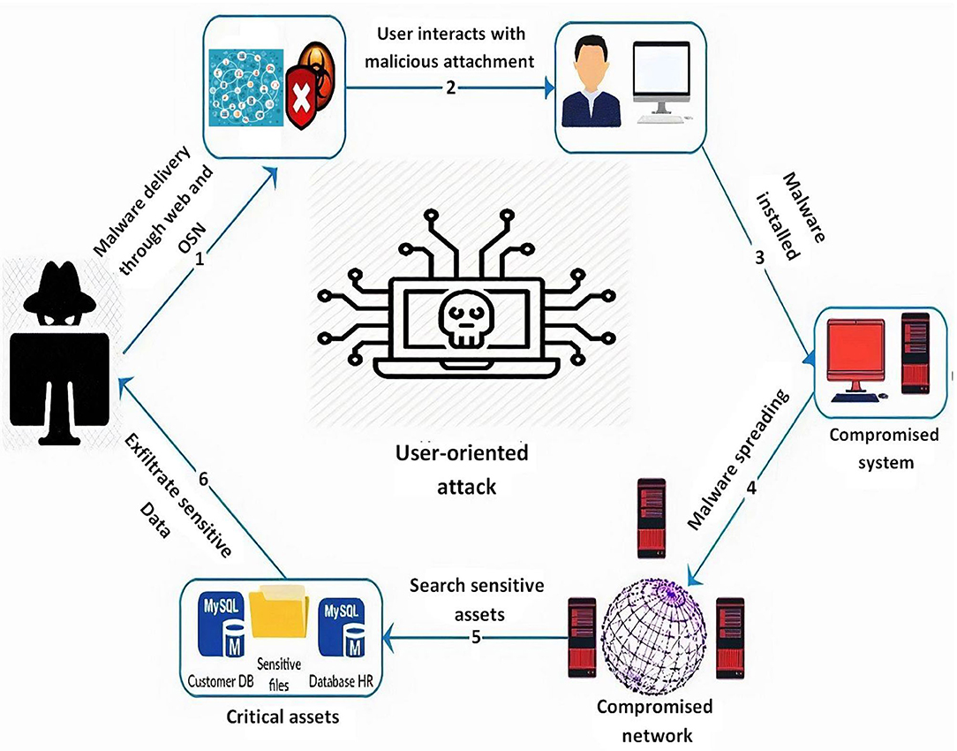
Name: Vadithya Sai Durga Naik
B Tech (bachelors of Technology )
FINAL PROJECT In Cyber security Kali Linux “Course”
APSSDC
#ph: 9515074905 mail: vsaidurga143@gmail.com
Rajiv Gandhi University of Knowledge Technologies
,Srikakulam,S.M Puram (521202),Ap

Slide 2

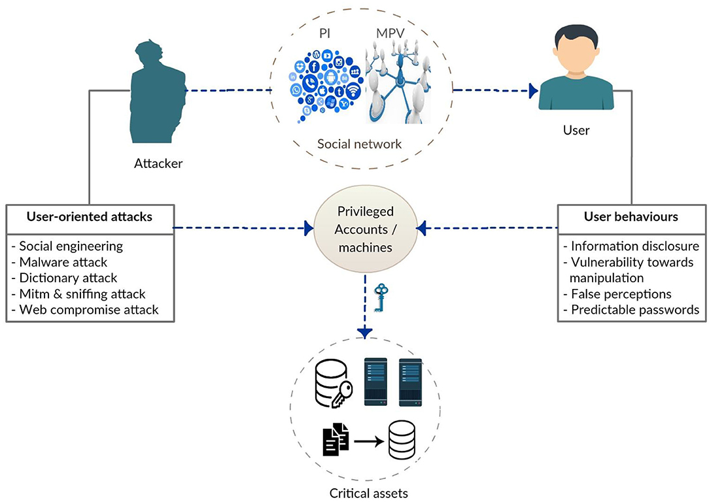
PROJECT TITLE
KEY LOGGGER
AND
SECURITY

Slide 3



AGENDA
Introduction
Problem Statement
Project Overview
Who Are The End Users
Solution and Value Proposition
The "Wow" in Our Solution
Modelling
Results
Conclusion and Q&A

Slide 4
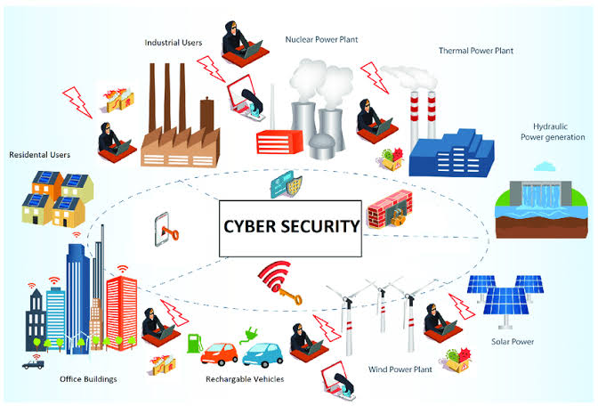
INTRODUCTION
Key loggers also known as keystroke loggers, may be defined as the recording of the key pressed on a system and saved it to a file, and the that file is accessed by the person using this malware. Key logger can be software or can be hardware.
Working: Mainly key-loggers are used to steal password or confidential details such as bank information etc.

Slide 5

PROJECT OVERVIEW
Develop a comprehensive understanding of keyloggers, their types, how they work, and effective security measures to prevent keylogging attacks.

Slide 6

WHO ARE THE END USERS?
End users are the individuals within an organization who interact with various digital platforms, applications, and devices daily. They are often the first line of defense against cyber threats.

Slide 7

PROBLEM STATEMENT
Keyloggers are a significant threat to cybersecurity, leading to unauthorized access to sensitive information , identity theft, and financial fraud.
Affects individuals, businesses, and organizations by compromising data privacy and security.

Slide 8

SOLUTION AND VALUE PROPOSITION
Anti-Key-logger – As the name suggest these are the software which are anti / against key loggers and main task is to detect key-logger from a computer system.
Anti-Virus – Many anti-virus software also detect key loggers and delete them from the computer system. These are software anti-software so these can not get rid from the hardware key-loggers.
Automatic form filler – This technique can be used by the user to not fill forms on regular bases instead use automatic form filler which will give a shield against key-loggers as keys will not be pressed .
One-Time-Passwords – Using OTP’s as password may be safe as every time we login we have to use a new password.
Patterns or mouse-recognition – On android devices used pattern as a password of applications and on PC use mouse recognition, mouse program uses mouse gestures instead of stylus.
Voice to Text Converter – This software helps to prevent Keylogging which targets a specific part of our keyboard.

Slide 9

THE WOW IN YOUR SOLUTION
Innovative Approach: Combining technical measures with user education for comprehensive protection.
Demonstration: Real-time demonstration of a simple keylogger to illustrate the threat and the effectiveness of security measures.
Impact: Significant reduction in the likelihood of keylogging attacks through proactive measures.
9

Slide 10
MODELLING
(Teams cam add wireframes)
Installing Required Libraries
Before we begin, we need to install a particular library, which we can do with the pip command: pip install pynput and pip install jsonlib.
Importing Required Libraries
pynput: This will help us read the keystrokes as the user types in stuff
JSON is a lightweight data-interchange format. It is often used for exchanging data between a web server and user agent
10

Slide 11
Initialization: Set up the main GUI window. Initialize global variables for key logging. Event Capture: Start capturing key events when the "Start" button is pressed. Log key press and release events. Data Logging: Continuously update text and JSON log files with captured key events. Stop Logging: Stop capturing key events when the "Stop" button is pressed. Update the GUI status to indicate the keylogger is stopped.

Slide 12
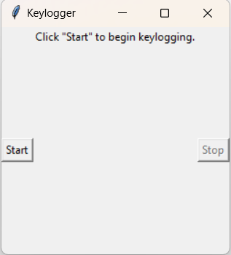
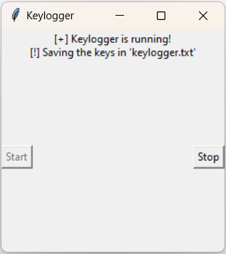
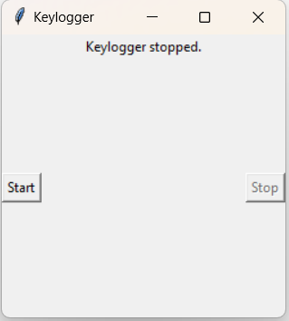
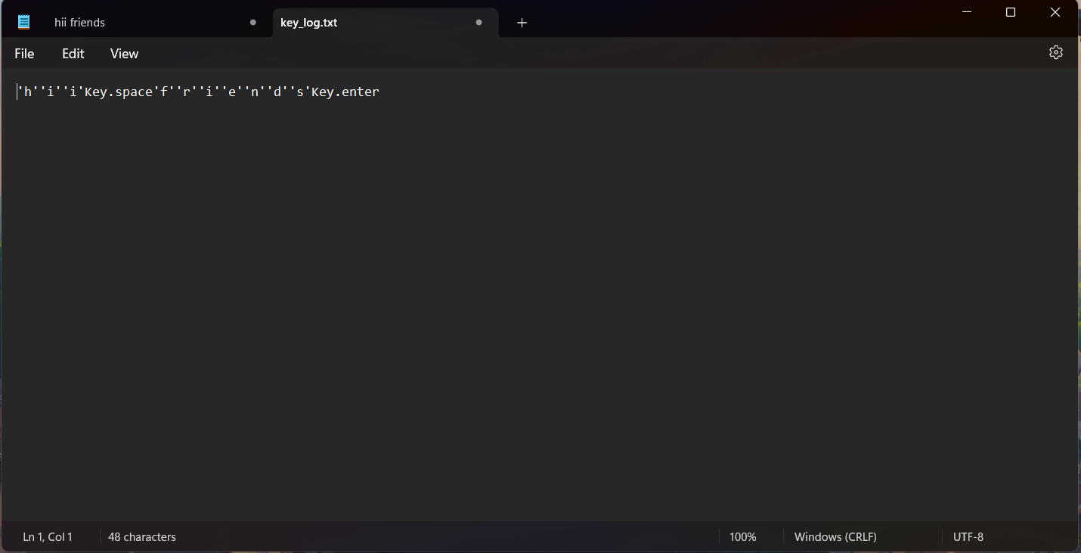
images

Slide 13
RESULTS
Successfully implemented a keylogger that captures keystrokes and records them into both text and JSON files.
Real-time keylogging with start and stop
functionality controlled via a simple GUI.
The keylogger project demonstrated the capability to effectively capture and log keystrokes in real-time.
The GUI provided a user-friendly way to control the keylogger, making it accessible and easy to use.
Emphasized the ethical use of keyloggers and the importance of implementing security measures to protect against malicious use.
13

Slide 14
GitHub link
https://github.com/VadithyaSaiDurgaNaik/vadithya-Sai-Durga-Naik-

